Slide 1
Project meeting (2016-12-05) - DVA313
Created by: Group 2 – Solar energy calculator

Slide 2
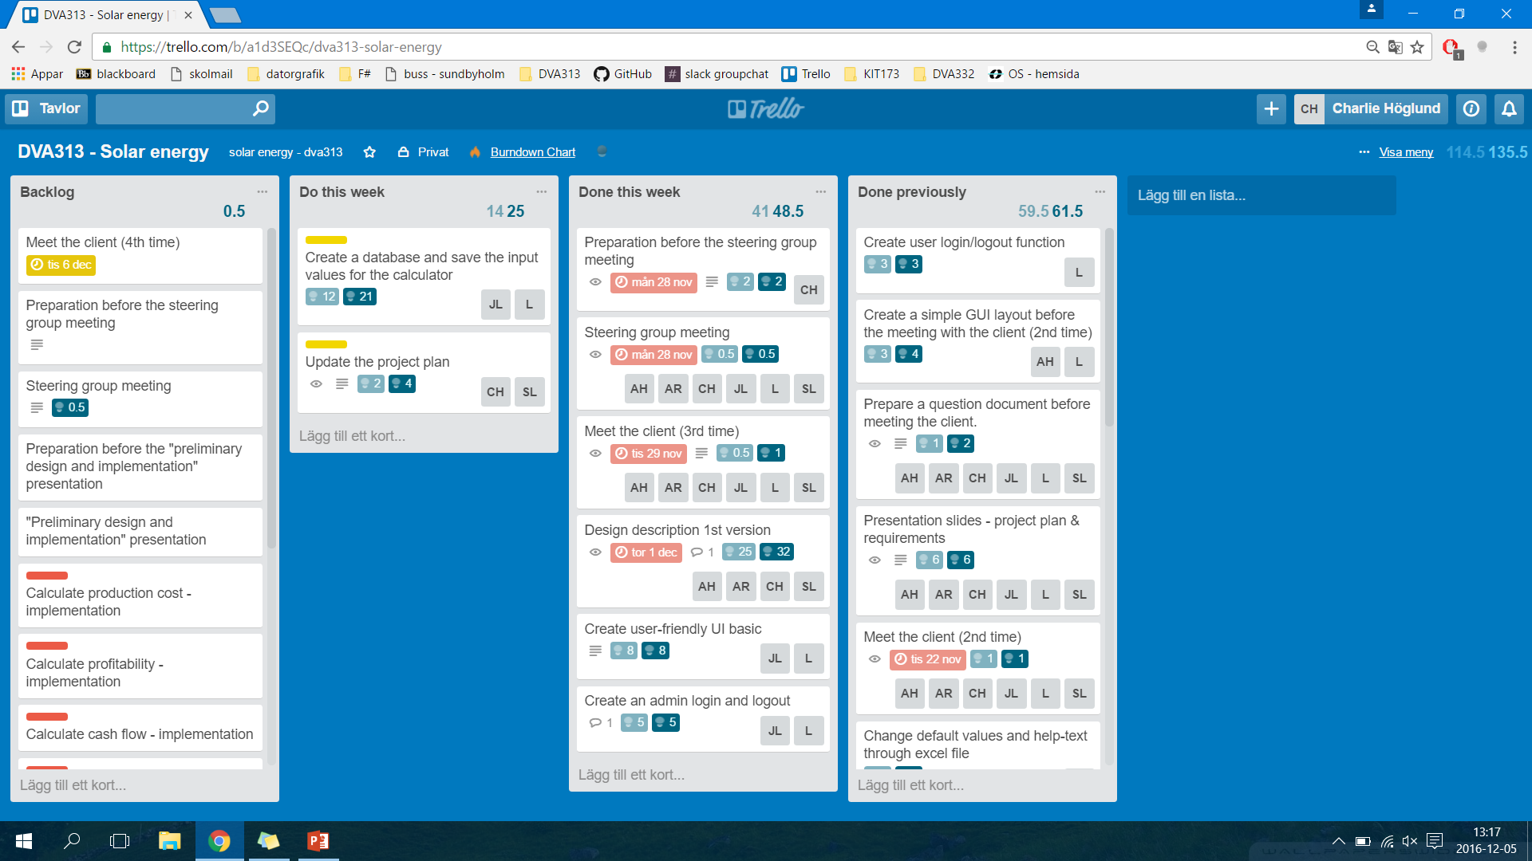
Trello board – Week 48 (previous)

Slide 3
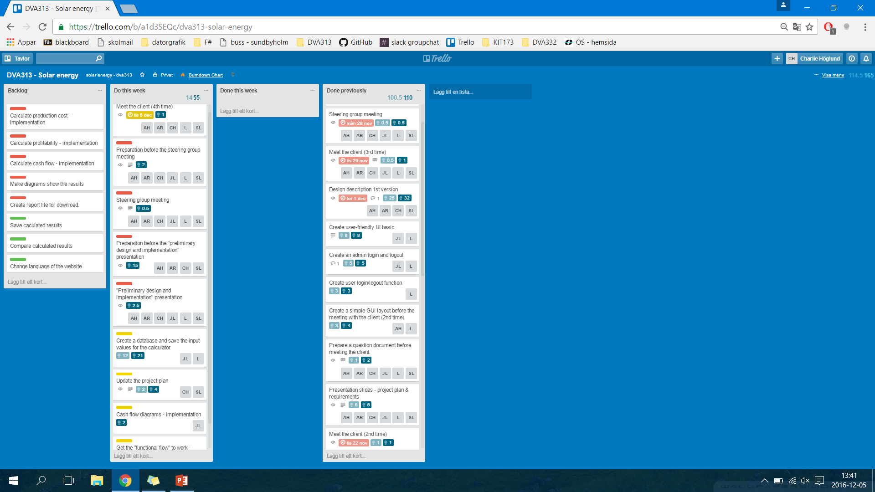
Trello board – Week 49 (present)

Slide 4
Any obstacles, risks or issues that have been identified
The client has given us some feedback on our product (1st version)
And it was very very goooood
We need to fix the design description document, since we will need this information for Wednesday’s presentation

Slide 5
Worked hours for each member
Name | Week 1 (hours) | Week 2 (hours) | Week 3 (hours) | Week 4 (hours) | Total
Lukas Hamacek | 6 | 18 | 10 | 15 | 49
Aliya Hussain | 7 | 16 | 9 | 10 | 42
Charlie Höglund | 8 | 19.5 | 14 | 18 | 59,5
Jonathan Larsson | 6 | 13 | 19.5 | 11 | 49,5
Sebastian Lindgren | 12.5 | 16.5 | 13 | 12 | 54
Avalika Reddy | 6 | 13 | 9 | 10 | 38

Slide 6
Questions for the steering group
Design description document:
Software architecture = three-tier architecture?
Detailed design = We have no selfmade classes. What’s being used are database tables, external libraries (include classes though), MVC?
Use case diagram

